Slide 1
Milestone review
By Adam Szlamp

Slide 2


Slide 3
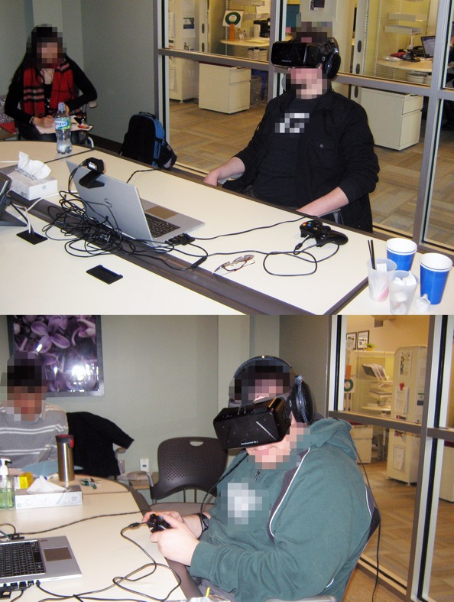
Original Brief
Design an environment that can develop key skills for Autistic Groups
Using VR to support and give access to lifelong skills, for better outcomes
Use VR for testing and trying things out like Crossing the Road, developing Social skill etc
STATE OF THE ART TECHNOLOGY like Oculus or Vive

Slide 4
First Proposal
Have framework that works in a semi-realistic environment
Framework allow flexibility to work on multiple real-life skills
The VR should be useable with various VR controls
Allow for non-VR controls
The VR must be the most modern
The feedback must be accurate but not scary or off putting
Have the ability for additions or edit for the end-user

Slide 5
What the client wanted?
List of issues that need to made into scenarios for helping people such as:
Shopping
Building Relationships
Crossing the Road
Using the toilet
Help with Cooperation and Coordination
MUST have both controller and VR controls support
Must allow to access to source code or modifiable executable

Slide 6
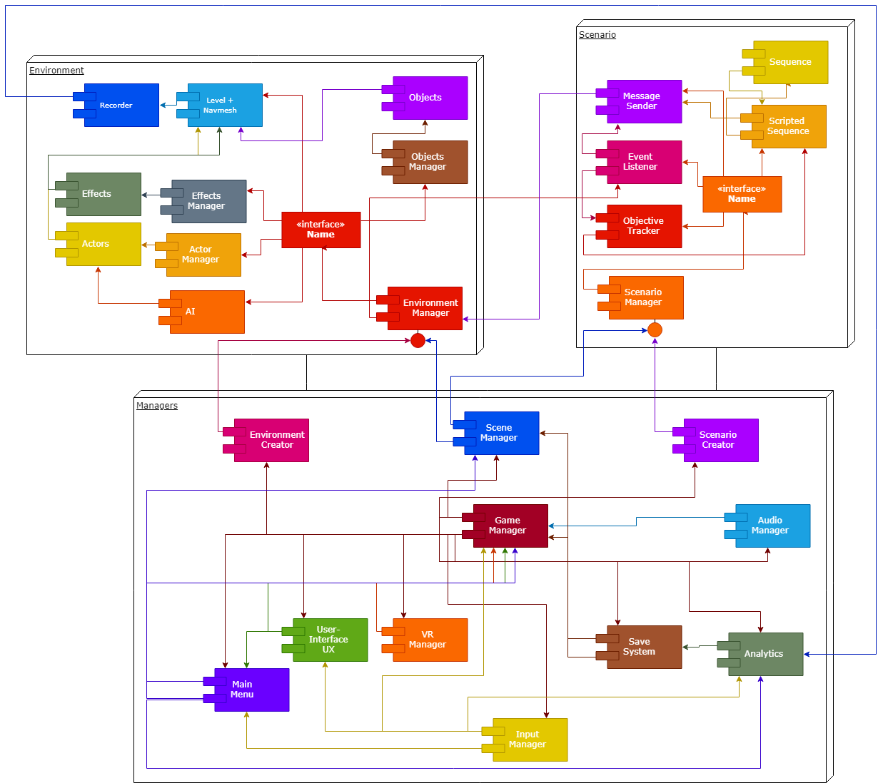
Original System Overview

Slide 7
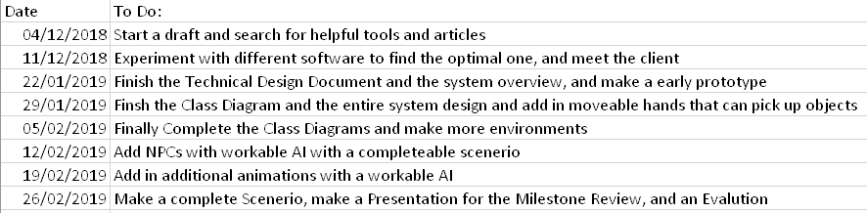
Original Milestone Outline

Slide 8
BACK TO
NOW

Slide 9
What has been added so far
Research Papers
Environments
NPCs
Scenario
VR Implementation

Slide 10
What changed from the proposal?
No more highly customizable Environment and Scenario maker
Super Scaled down size, AI abilities, interactions, detailing
The Range of tasks that can be completed

Slide 11
System Overview
MAXIMUM FIVE
SCENERIOS THAT CAN
BE COMPLETED
ANALYSED AND RECORDED

Slide 12
Scope
Each environment can only have one scenario
NPCs will be limited to only the scenario they star in
Limited but consistently simple UI
Analytics for only scenarios completed
Ambient sound effects, no music or voice.
Stiff animations

Slide 13
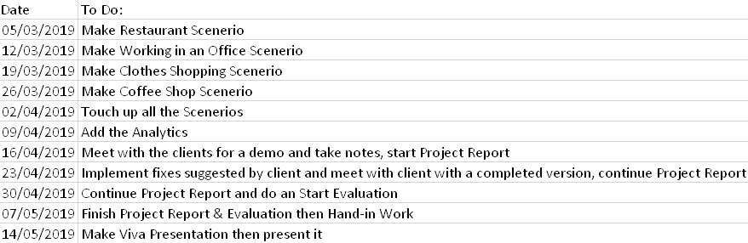
Milestone Outline

Slide 14
Research
What issues do autistic people face on a day to day basis?
What is necessary to make the VR controls head tracking as smooth as possible?
What are the best techniques for teaching autistic people?
What are the most common issues for autistic people?
What content is the most desperately needed?

Slide 15
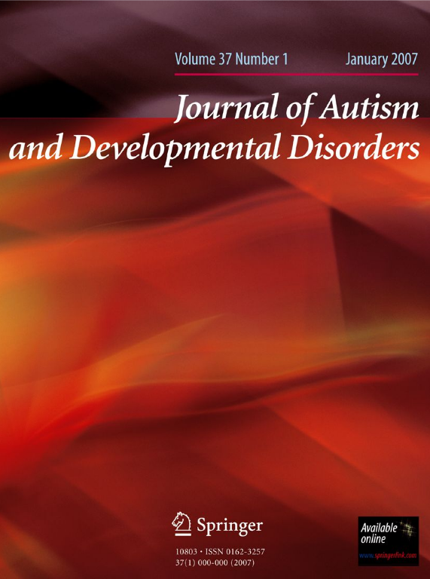
Journal of Choice & Requirements
Too many requirements and little formatting information to mention
So go to:- https://www.springer.com/psychology/child+%26+school+psychology/journal/10803?detailsPage=pltci_3161162

Slide 16
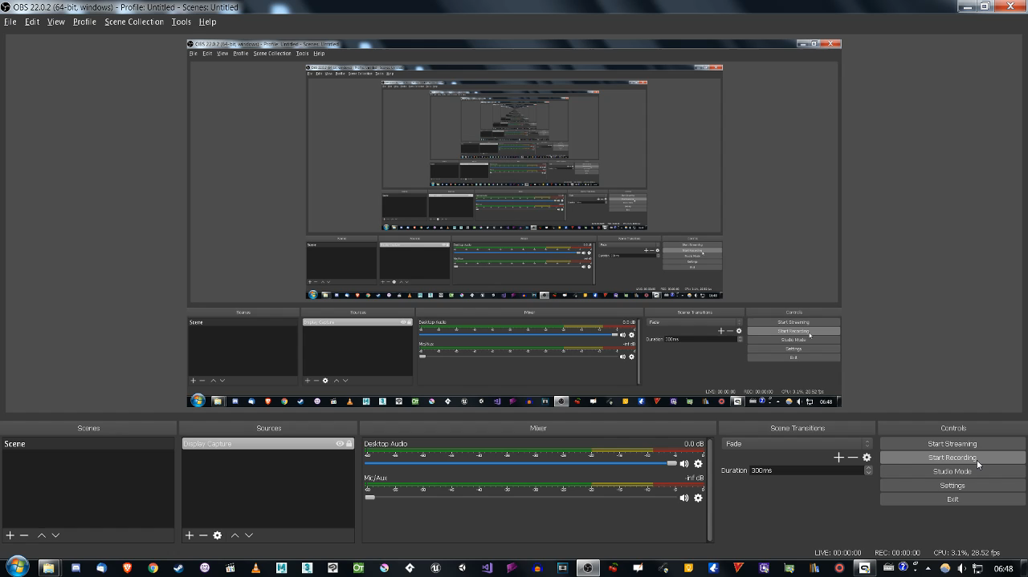
DEMO

